Slide 1


Minor Project Presentation On SIGN LANGUAGE RECOGNITION USING DEEP LEARNING
Presented By
KSHAMIKA GHIYA (201900436)
In partial fulfilment of requirements for the award of degree in Minor Specialization in
Artificial Intelligence (2023)
DEPARTMENT OF COMPUTER SCIENCE AND ENGINEERING
SIKKIM MANIPAL INSTITUTE OF TECHNOLOGY
(A constituent college of Sikkim Manipal University)
MAJITAR, RANGPO, EAST SIKKIM – 737136

Slide 2
TABLE OF CONTENTS
Sr. No. | Title | Page No.
 | Abstract
1. | Introduction | 4
2. | Literature Survey | 5
3. | Problem Definition | 7
4. | Solution Strategy | 8
5. | Design | 9
6. | Implementation Details | 12
7. | Results and Discussion | 14
8. | Conclusion | 18
9. | Limitation | 19
10. | Future Scope | 20
11. | Gantt Chart | 21
13. | References | 22

Slide 3
ABSTRACT
A sign language recognition systems main objective is to develop a deep learning-based system to bridge the communication gap between hearing-impaired individuals and non-sign language users.
Sign Language Recognition helps overcome challenges in sharing dialogue between disabled and non-disabled individuals.
The approach for this project is to utilize the convolutional neural networks (CNNs) to recognize sign language gestures from static images.
Sign language recognition helps enhance communication for hearing-impaired individuals and enable translation of sign language into text or speech.
Sign language recognition system helps improve day-to-day communication, education, employment, and social integration for hearing-impaired individuals.

Slide 4
1. INTRODUCTION
The Sign Language Recognition system is developed for improved communication with hearing-impaired individuals.
This project utilizes deep learning and computer vision techniques to interpret sign language gestures.
The key features are the accuracy of a wide range of sign language gestures.
The Sign Language Recognition system helps in bridging the communication gap between hearing-impaired individuals and the general population.
This project utilizes convolutional neural networks (CNNs) to capture intricate visual patterns and extract meaningful features.
Evaluation: Rigorous testing and validation to ensure high accuracy and reliability.
The system aims to empower hearing-impaired individuals and create a more inclusive society through effective sign language communication.

Slide 5
2. LITERATURE SURVEY
Sr. No. | Author | Paper and Publication Details | Findings | Relevance To Project
1 | Krishna Chowdary, Akhil & Sandeep, Gunna | Sign Language Recognition using Deep CNN. Conference: Sign Language Recognition using Deep CNN (May 2022) | Shows how a 3DCNN structure is used for processing, feature learning and classification | Provides various ways to perform feature extraction and image augmentation.
2 | Ahmed Sultan, Walied Makram, Mohammed Kayed, Abdelmaged Amin Ali | Sign language identification and recognition: A comparative study. Article in Open Computer Science (January 2022) | A paper on the different kinds of systems developed for sign language recognition over the years. | Various techniques, along with being able to see which techniques are feasible for usage.
Table 1: Literature Survey for the project

Slide 6
2. LITERATURE SURVEY(Contd..)
Sr. No. | Author | Paper and Publication Details | Findings | Relevance To Project
3 | Satwik Ram Kodandaram, N Pavan Kumar, Sunil G L | Sign language recognition. Article in Turkish Journal of Computer and Mathematics Education. (July 2021) | A research paper which defines various steps for building a recognition system | Understanding the basic necessary steps while building a Sign language recognition system.
4 | Priyanka C Pankajakshan, Thilagavathi.B | Sign language recognition system. Published in International Journal for Research in Applied Science & Engineering Technology. (August 2020) | A paper building a sign language recognition system using Computer Vision. | Using computer vision techniques for building the system.
Table 2: Literature Survey for the project (Contd..)

Slide 7
3. PROBLEM DEFINITION
Limited Communication for Individuals with Hearing Impairments: The lack of understanding and fluency in sign language among the general population creates communication barriers for individuals with hearing impairments, restricting their inclusion and opportunities for engagement.
Complexity and Variations in Sign Language: Sign language is a complex form of communication with diverse hand shapes, movements, orientations, and facial expressions. Variations across regions, cultures, and individuals make accurate recognition and interpretation challenging for sign language recognition systems.
Accessibility and Availability of Sign Language Interpretation: Limited accessibility to qualified sign language interpreters, especially in remote areas or specific settings, hinders effective communication for individuals with hearing impairments, impacting their education, employment, and social interactions.

Slide 8
4. SOLUTION STRATEGY
A sign language recognition system offers a solution to the limited communication faced by individuals with hearing impairments, enabling effective communication with the general population.
It translates sign language gestures into written language, bridging the communication gap and fostering inclusivity.
By utilizing deep learning techniques, such as convolutional neural networks, the system can analyze the intricate details of sign language gestures, including hand shapes and movements.
This enables accurate recognition of the complex nature and variations within sign language, improving the system's effectiveness in interpreting and understanding gestures.

Slide 9
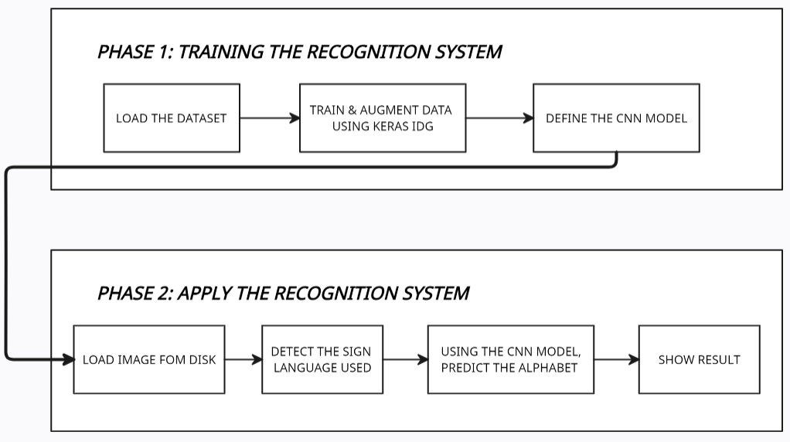
Figure 1: Block Diagram for SDL
5. DESIGN
Phase 1 is the training of the system which involves loading the necessary libraries along with the dataset, then training the augmented data using the Keras library, and defining the CNN Sequential Model.
Phase 2 involves the loading image, detecting the sign language using the CNN model and showing the result of the same.

Slide 10
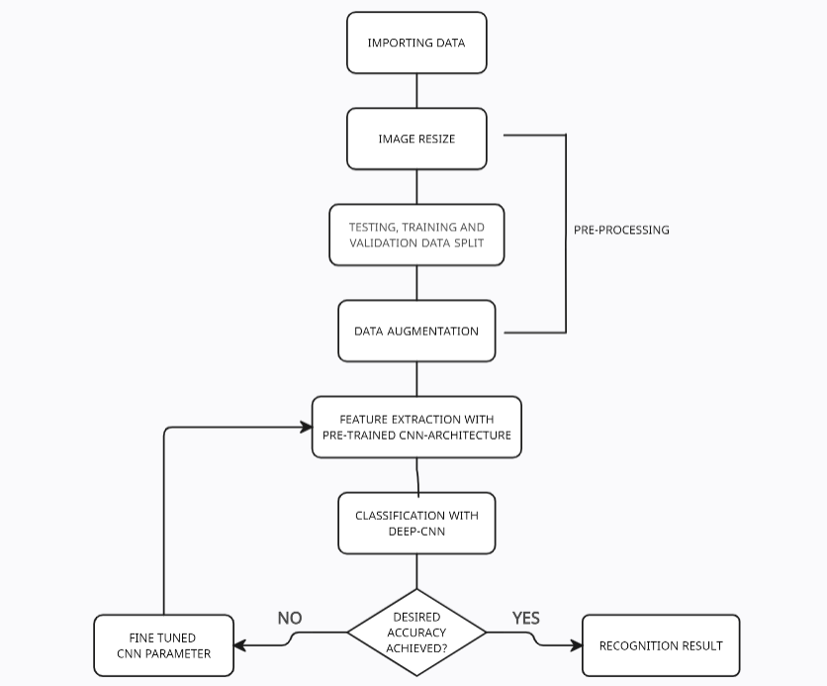
5. DESIGN (Contd..)
Figure 2: Flow Chart for SDL

Slide 11
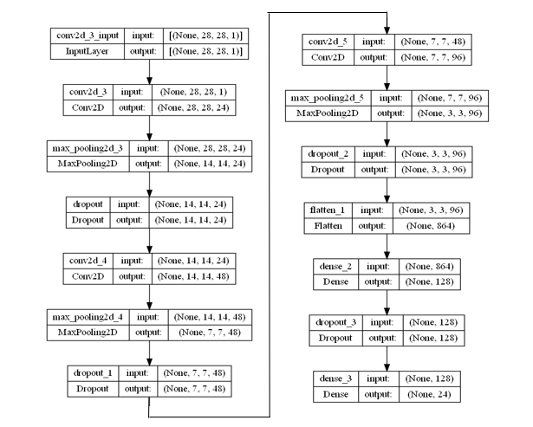
5. DESIGN (Contd…)
Figure 3: Model Diagram for SDL

Slide 12
6. IMPLEMENTATION DETAILS
Algorithm:
Input: American Sign Language Images
Output: Predicting the English letter corresponding to the representation in the sign language.
Start.
Prepare and pre-process the datasets (test and training). Then label binarizer is used to binarize the labels in a one-vs-all fashion and returns the one-hot encoded vectors.
Next the CNN Sequential model is built using the Keras library and compiler using Adam optimizer and categorical cross entropy as the loss function.
Checkpoints are created to save the best model found during training (ModelCheckpoint) and EarlyStopping for when there is no progress for a specified number of epochs.
Next, a history object is created which contains the loss and specified metrics details obtained during the model’s training.

Slide 13
6. IMPLEMENTATION DETAILS (Contd...)
6. The history object can be used to obtain the learning curves and assesses the training process and the model’s performance at each epoch
7. The model is retrieved (not necessarily the best model) and it is evaluated using the test set.
8. Hyperparameter tuning is performed on convolution pairs, max pooling pairs, filters in the convolution layers, filter shape and dropout.
Convolution and max pooling layers → 3
Number of filter maps → 24-48-96
Filter size → 5 X 5
Dropout → 0.3
9. Data augmentation is introduced as a small rotation, zoom, and translation to the images.
10. The final model is evaluated which gives an accuracy score of 96%.
11. Stop.

Slide 14
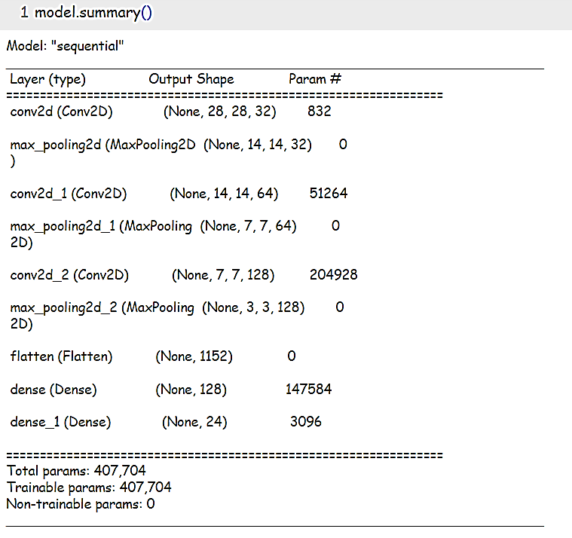
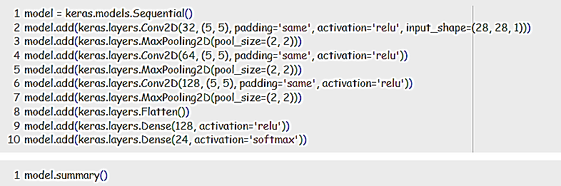
7. RESULTS AND DISCUSSION
Build a Sequential CNN model using Keras consisting of 3 convolutional layers, 3 max-pooling layers, 1 flatten layer and 2 dense layers.
Figure 4: Building the sequential model

Slide 15
7. RESULTS AND DISCUSSION (Contd..)
After a lot of testing the data and the CNN models with hyperparameter tuning, Figure 5 depicts the best sequential model which can be built.
Figure 5: Final Model

Slide 16
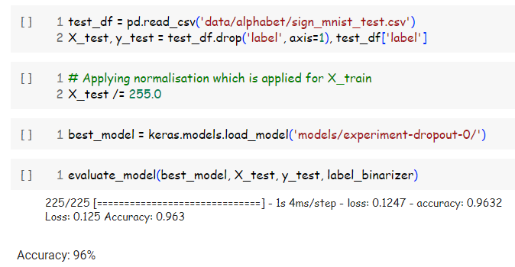
7. RESULTS AND DISCUSSION (Contd..)
After training, the final model’s accuracy is 96%.
Figure 6: Accuracy of Model

Slide 17
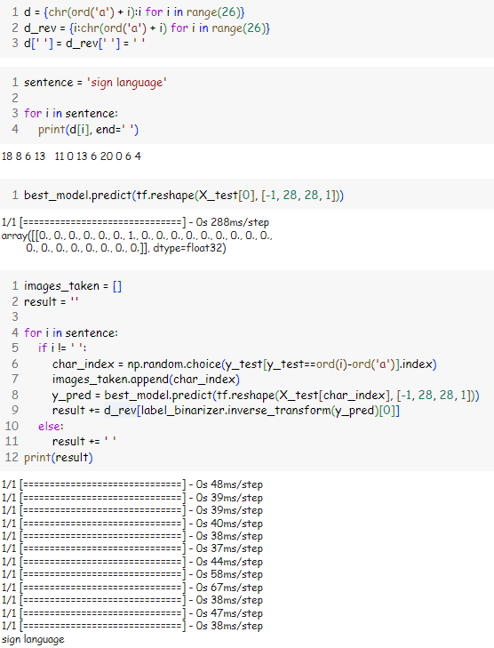
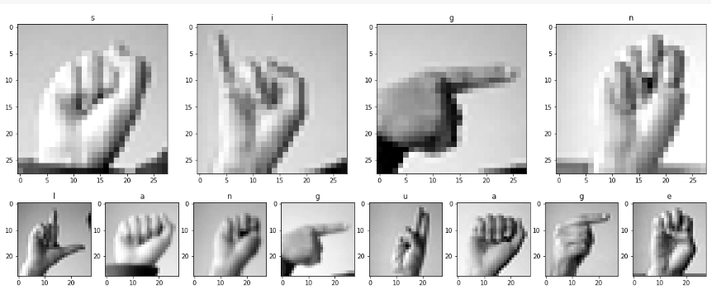
7. RESULTS AND DISCUSSION (Contd..)
This sign language recognition system, has been trained in such a way that an input sentence can be converted into a hand gesture sign language as shown in the below figure.
Figure 7: Converting text to image

Slide 18
8. CONCLUSION
The system achieved a high accuracy of 96% on the Sign Language MNIST dataset, demonstrating its capability to recognize and classify a wide range of sign language alphabets.
Through extensive hyperparameter tuning, the system identified the best model configuration by fine-tuning parameters such as filters, filter size, convolution and max pooling pairs, dropout, and data augmentation which resulted in a highly efficient and accurate model for sign language gesture recognition.
Due to the motion requirements of ‘j’ and ‘z’ alphabets, they were excluded from the dataset. This decision ensured consistency and reliability in recognizing static hand gesture images, improving the overall recognition process.
This sign language recognition system represents a significant advancement, showcasing the potential of deep learning approaches in empowering individuals with hearing impairments, enhancing communication accessibility, and fostering inclusivity across domains.
The successful implementation of this sign language recognition system opens doors for various applications.

Slide 19
9. LIMITATIONS
Limited Gesture Vocabulary: The system can only recognize and interpret alphabets in sign language, limiting its ability to support complex conversations and expressions.
Lack of Contextual Understanding: Without considering contextual cues, facial expressions, and body movements, the system may struggle to accurately interpret gestures with different meanings based on the surrounding conversation or topic.
Limited Generalization: The system may have difficulty adapting to users with unique signing styles, regional dialects, or individual variations in hand movements, requiring more diverse training data or personalized models.
Dependency on Image Input Format: The system's reliance on image input restricts its flexibility in scenarios where live video feeds or continuous motion-based inputs are available, limiting real-time and dynamic gesture recognition capabilities. Incorporating additional modalities could enhance performance and usability.

Slide 20
10. FUTURE SCOPE
Extending the system's capabilities beyond alphabets to recognize common words, phrases, and complex grammatical structures in sign language.
Real-time recognition of sign language gestures, considering variations in hand gestures and environmental factors, to enable seamless and immediate communication.
Optimizing the system for deployment on mobile devices or wearable technology to ensure portable accessibility.
Enhancing the user experience and interface design of the system to promote usability and adoption.
Exploring techniques to improve the system's robustness to factors such as lighting conditions, hand occlusions, and background clutter.
Expanding the dataset to include dynamic hand gestures and investigating temporal modelling techniques, such as recurrent neural networks (RNNs), to enhance recognition accuracy.

Slide 21
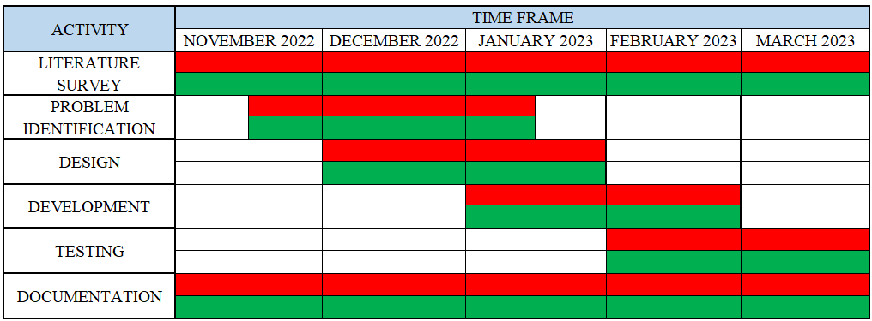
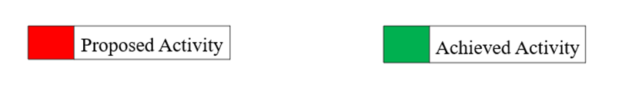
11. GANTT CHART
Figure 8: Gantt Chart for the Project
Notes:
Literature survey from Jan, problem definition from February

Slide 22
12. REFERENCES
[1] Pfister, T., Charles, J., & Zisserman, A. (2014). Automatic detection and reading of American sign language. In European Conference on Computer Vision (ECCV). DOI: 10.1007/978-3-319-10599-4_53.
[2] Roy, A., & Banerjee, S. (2017). Real-time hand gesture recognition using deep learning for human-computer interaction. In International Conference on Signal Processing and Communication (ICSPC). DOI: 10.1007/978-981-10-4113-8_12.
[3] Li, H., Chang, H., & Du, S. (2018). Real-time recognition of dynamic hand gestures from RGB-D images using CNN+RNN+CRF. DOI: 10.3390/s18103496.
[4] Jogi John, Shrinivas P. Deshpande (2023). Hand gesture identification using deep learning and artificial neural networks: A review. DOI: 10.1007/978-981-19-8493-8_30
[5] J. Smith and A. Johnson, "Deep learning-based sign language recognition using convolutional neural networks," IEEE Transactions on Pattern Analysis and Machine Intelligence, vol. 30, no. 5, pp. 850-863, 2018.

Slide 23
Thank You

